Slide 1
Inter-municipal Collaboration Frameworks
Under The Modernized Municipal Government Act
Regional Collaboration Panel

Slide 2
INTRODUCTION
“
Coming together is a beginning;
Keeping together is progress;
Working together is success.
Henry Ford
”

Slide 3
INTRODUCTION
Bill 21 - The Modernized Municipal Government Act
Inter-municipal Collaborative Framework (ICF)
Municipal Services
ICF

Slide 4
INTRODUCTION
Bill 21 - The Modernized Municipal Government Act
Inter-municipal Collaborative Frameworks
Mandatory - Required within 2 years of coming into force
Required with each of your shared boundary neighbours (subject to a few exceptions, like growth management boards)
Purpose - to provide for:
  Integrated and strategic planning and service delivery
  Efficiencies
  Balancing benefits and burdens
Must include an Inter-municipal Development Plan (IDP)
Must have a plan for implementation

Slide 5
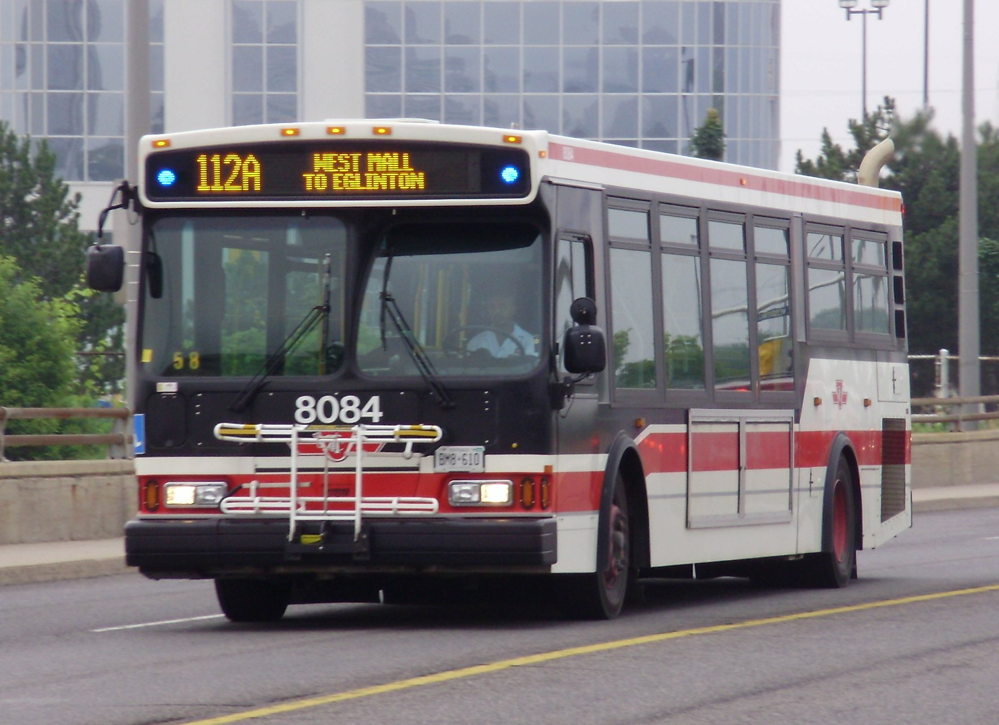
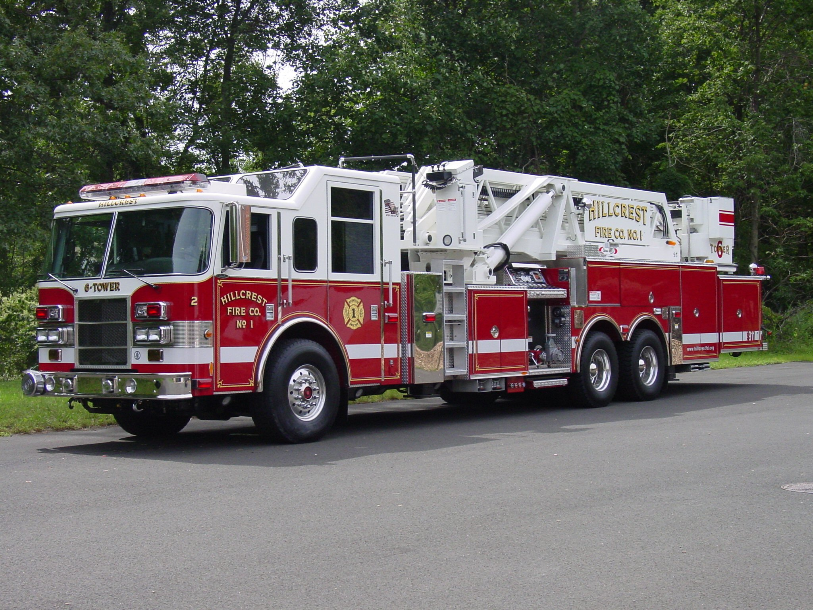
INTRODUCTION
ICF’s must address:
Inter-municipal Collaborative Framework
Transportation
Water/Wastewater
Recreation
Other Services
Emergency Services

Slide 6
INTRODUCTION
What Successful Collaborations have in Common?:
Comprehensive
Balanced
Mindset & Lifestyle Change
Relationship & Trust
Collective Vision
Mission
Realistic/Long Term Outlook

Slide 7
INTRODUCTION
What Successful Collaborations have in Common:?
ICF
Plan
People
Right People in the Room, Right Time
Strategic Plan for Implementation

Slide 8
INTRODUCTION
ICF Process:
Relations,
Principles &
Visions
Information
Gathering
Analysis & Discussion
Development of Options & Framework
Preparation of Framework and IDP
Establish & Revise Bylaws
Implementation

Slide 9
KEY ROLES & PERSPECTIVES
The Champion/Relationship Manager
Researcher/Data Cruncher
Legal Guide
Engineer
Planner
Financial Analyst
Not exhaustive…in addition to project management, and additional roles internal to each municipality…

Slide 10

Michael Solowan, B.A., LLB
Partner, Brownlee LLP
msolowan@brownleelaw.com
780-497-4893

Slide 11



Municipal Purposes
To provide good government.
To develop and maintain safe and viable communities.
To provide services, facilities, or other things necessary or desirable for the municipality
MGA, s. 3

Slide 12

OLD INTERMUNICIPAL PARADIGM

Slide 13


NEW PARADIGM - NEW PURPOSE
“to work collaboratively with neighbouring municipalities to plan, deliver and fund intermunicipal services.”

Slide 14
NEW PARADIGM - NEW PURPOSE
Fundamental shift in local government in Alberta
New perspective/lens to filter decisions through
No municipality is an island
Question: what is/can/should be an intermunicipal service

Slide 15
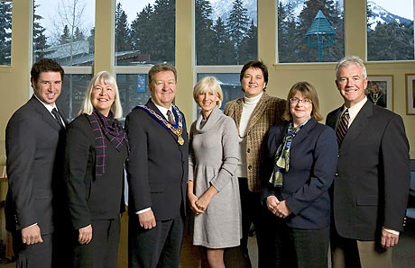
NEW PARADIGM - NEW PURPOSE
“to promote an integrated and strategic approach to intermunicipal land use planning and service delivery with neighbouring municipalities.”

Slide 16
NEW PARADIGM - NEW PURPOSE
Fundamental shift in councillor statutory duties
New perspective/lens to filter
Go beyond considering and promoting the welfare & interests of municipality as a whole – neighbours/intermunicipal

Slide 17


GOAL
Optimize collective resources (financial, tangible assets, personnel) to ensure the long-term viability of your region through efficient and effective delivery of services to the people.

Slide 18

Doug Griffiths
President & CEO
doug@13ways.ca
587.335.0013
Chris Fields
Senior Strategist
chris@13ways.ca
587.335.0013

Slide 19

Chris Ulmer, RPP, MCIP, CNU-A Community Consultant 780 430 4041 Ext. 2258 culmer@urbansystems.ca

Slide 20
Dan Hanson IMPACT Consulting (780) 425-1990 www.impact-consulting.ca
Ian McCormack Strategic Steps Inc. 780-416-9255 ian@strategicsteps.ca

Slide 21
ICF CREATION PROCESS:
HOW TO GET THERE FROM HERE
Identify Participants
Analysis of Survey Results
Draft ICF and Implementation Plan
Council Adoption and Reporting
Ongoing Review and Amendments
Online Survey
© www.strategicsteps.ca
www.impact-consulting.ca
Notes:
www.strategicsteps.ca

Slide 22
SOME ICF CONSIDERATIONS
Budgetary considerations:
  Cost splitting for delivery of identified services
  Potential for cost savings
  Grant support
Collaboration:
  Where are the obvious points – ‘low-hanging fruit’
  Where are you already collaborating
  Focus on areas of agreement
© www.strategicsteps.ca
www.impact-consulting.ca

Slide 23
SOME ICF CONSIDERATIONS
Who drives the process
  Administration and Council engaged throughout
How are Indigenous communities involved?
Which other statutory and non-statutory plans are affected?
Do you have:
  The capacity?
  The expertise?
  The objectivity?
© www.strategicsteps.ca
www.impact-consulting.ca

Slide 24
ICF TIMELINE
Identify Participants | 1 -2 Months
Online Survey | 1 – 2 Months
Analysis of Survey Results | 6 -12 Months
Draft ICF and Implementation Plan | 1 – 4 Months
Council Adoption and Reporting | 2 -3 Months
Ongoing Review and Amendments | Varies, MGA Timelines
Must be implemented within two years… get started. Must be reviewed within five years and updated if required.
© www.strategicsteps.ca
www.impact-consulting.ca

Slide 25
Rodd C. Thorkelsson, B.A., LLB
Partner, Brownlee LLP
rthorkelsson@brownleelaw.com
780-497-4801

Slide 26
INTRODUCTION
What Successful Collaborations have in Common:?
By Agreement
Funding Agreement
Service/Supply Agreement
By Joint Ownership/Governance Structures

Slide 27
John C. McDonnell, B.A., LLB
Partner, Brownlee LLP
jmcdonnell@brownleelaw.com
780-497-4801

Slide 28

ICF IMPLEMENTATION
Decision made to provide regional service
What are our options?
Notes:
This assumes that parties have already gone through the analysis of types of services
They have already decided to proceed with the joint/regional types of services

Slide 29

ICF IMPLEMENTATION
1. Proceed with Regional Agreement
  No new entity is used
2. Create new entity
  Entity will be service provider
Notes:
Options are
do this under an Agreement
Create new entity which will own and operate the system

Slide 30

WHAT’S THE DIFFERENCE?
Why would the regional group proceed with only an agreement in one instance and a new entity in the other?
Notes:
Explain main difference
Regional Agreement – used in simpler arrangements/types of services
Already likely discussed how this is used: Examples are
Joint FCSS
Joint planning services
Joint subdivision approval
One party owns and operates and provides services to other: Like firefighting
Separate legal entity
To be discussed down the road

Slide 31

REGIONAL AGREEMENT
Entire service relationship is done via agreement
Used in simpler matters

Slide 32
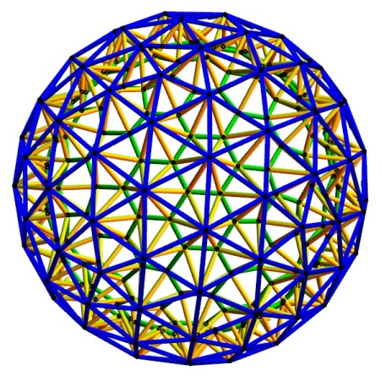
REGIONAL ENTITY
  This is used in following circumstances:
  Long term service (ex. decades)
  Collectively owned assets
  Each makes big capital contributions
  Meant to be a regional system
Notes:
Long term service. This is where service will last over multiple councils and administrations. People forget over time
Parties will collectively own the assets and all assets are integral to the service
Each has to make big capital contribution
This is meant to be a collectively owned and operated service. It’s not just one party owning it all and providing service to the others as customers
Most commonly used for utilities such as:
Transportation
Water
Wastewater
Solid Waste
Airport
Electricity

Slide 33
REGIONAL ENTITY
  Typical options are:
  Municipally controlled corporation
  Regional services commission
  Part 9 Company
  Society
  Federal Non-Profit Corporation
  Cooperatives

Slide 34
Municipally Controlled Corp
  Characteristics are:
Separate legal entity
Can pay dividends
Recognizes proportionality of interests
Most flexible of all options, once created
No longer needs Ministerial consent to create
Best model to allow direct Council control
  Governed by Business Corporations Act

Slide 35
Regional Services Commission
  Characteristics are:
    Probably most common type for regional services
    No proportionality of ownership interests
    Subject to significant Provincial oversight
    Limited to types of services that can be provided
    Cannot pay out profits/excess revenue
    Hardest entity to create
    Most regulated type of entity out there!!
  Governed by MGA

Slide 36
Part 9 company
  Characteristics are:
Non-profit entity
Deemed to be a separate legal entity
Can have proportionality of interest
Easy to bring in new members
No Ministerial consent needed to create
Hard to change corporate constitution later
  Governed by Companies Act

Slide 37
SOCIETY
  Characteristics are:
Non-profit entity
Separate legal entity
No proportionality of ownership interest
Easier to bring in new members
No Ministerial consent needed to create
Better statute to work with than Companies Act for corporate compliance
  Governed by Societies Act

Slide 38
Federal non-profit corporation
  Characteristics are:
Non-profit entity
Separate legal entity
No proportionality of ownership interest
Easier to bring in new members
No Ministerial consent needed to create
Best/most modern non-profit corporate statute to govern the parties
  Governed by Canada Not-for-Profit Corporations Act

Slide 39
Cooperative
  Characteristics are:
Separate legal entity
Allows distribution of profit on equal basis
No proportionality of ownership interest
Easy to bring in new members
No Ministerial consent needed to create
  Governed by Cooperatives Act

Slide 40

Questions?
Thank You!
  John McDonnell
  780-497-4801
  jmcdonnell@brownleelaw.com

Slide 41
Michael Solowan, B.A., LLB
Partner, Brownlee LLP
msolowan@brownleelaw.com
780-497-4893

Slide 42


ICF DISPUTE RESOLUTION
1. Negotiation
2. Mediation
3. Arbitration

Slide 43
ICF DISPUTE RESOLUTION
Negotiation | Mediation | Arbitration
Less time | More time | Most time
Less costly | More costly | Most costly
Informal/ facilitated | More formal | Quasi-judicial
Parties decide process | Mediator drives process | Arbitrator dictates process
Parties decide outcome | Mediator influences outcome | Arbitrator imposes outcome

